Slide 1
Deal Me
IBM Team 2
David Le, Aditya Modi, Nima Rahnemoon, Rohit Seth, Jessica Tai, Stephanie Tung, Uen-tao Wang, David Yang

Slide 2
Motivation
Many online deal listing sites
Additional steps/sites needed for:
More information on deal venues
More type specificity
Directions
Locality
Including friends

Slide 3
Goal: DealMe Website
Aggregate deals by
Location
Type (dining, entertainment, shopping, etc)
Provide more information
Yelp stars, preview of reviews
Directions to venue
Social media integration

Slide 4
System Overview
API web mash-up
Yipit : deal aggregator
Google maps : location, directions
Yelp: reviews, ratings
FB: share with friends, events
Twitter: tweet to friends
Google Web Toolkit (GWT)
Java RPC
JSON

Slide 5
Architecture Diagram
Model-view-presenter (MVP) architecture
(demo code architecture)
(explain why chose MVP)
Easy separation of tasks

Slide 6
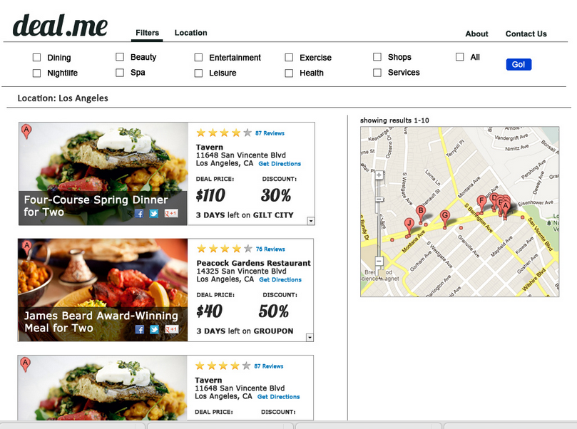
Interface Design

Slide 7
UML/Sequence Diagrams
UI widget → servlet → RPC call → parse data → client (UI)?

Slide 8
Workflows

Slide 9
Other Considerations
Security
Not necessary
Users not required to log-in
Database
Not necessary
No information stored about user info/activity

Slide 10
Schedule & Milestones
Requirements/SRS
Complete skeleton code
Finalize design mockups
Complete final implementation of subsets
Yipit API
Google maps API
Yelp API
Social media (FB/Twitter)
Final report
Demo

Slide 11
Progress Thus Far
(demo?)

Slide 12
Challenges & Lessons Learned

Slide 13
Uncompleted Tasks

